Slide 1





Slide 2

Product Benefits
TURNING DATA INTO DOLLARS

Slide 3

Relationship Retention and Enhancer for your Sales People

Slide 4

Farms are living
Farms stay up to date
All ownership information changes as homes sell
All property characteristics stay update
No need to download again

Slide 5

Analytic email Notifications
Get emails and app push notifications
Stat updates
Turn over Rate
Who Moved / Sold / Listed

Slide 6

Create your own Custom Data filters
Define the data you want to see and create output based on that data

Slide 7
Life Event Data
Get notified of Life Events in your area as they happen
Marriages
Deaths
Probate
Distress Properties
Births
Divorces
Notice of Defaults
Notice of Trustee Sales

Slide 8

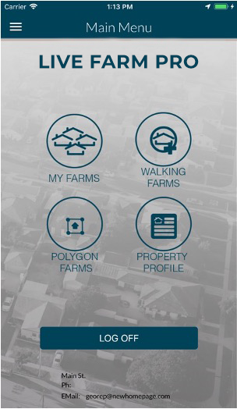
Need Emails and Phones
The most current Premium Emails and phones
Process an entire file or one address at time

Slide 9

Integrated Email Marketing System
Built in Marketing content for Real Estate Sales
⇒ 120+ built in eletters 

Slide 10

Built in Marketing Filters
Helps you quickly find the marketable aspects of a farm
Anniversary
Previously Listed
Likely Movers
Investment Properties
Flippers
Over 30 built in marketing filters + Custom

Slide 11









Life Style Data
Age
Estimated Fico
Interests

Slide 12

The Output you need
Over 20 CRM output formats
CRM
Direct Printer Interfaces
Labels
Reports

Slide 13

Analytic Reports
City Break downs
Historical views

Slide 14

Social Media Instant Ad Placement
Instantly place Facebook and Instagram Ads
®
®
Create and manage Facebook Audience files

Slide 15

Thank You
This material is meant for general illustration and/or informational purposes only. Although the information has been gathered from sources believed to be reliable, no representation is made as to its accuracy. This material is not intended to be construed as legal, tax, or investment advice. You are encouraged to consult your legal, tax, or investment professional for specific advice. Data is collected, managed and provided by a third party. All data upgrade purchases are verified for compliance by the third-party, NewHomePage.

